Slide 1
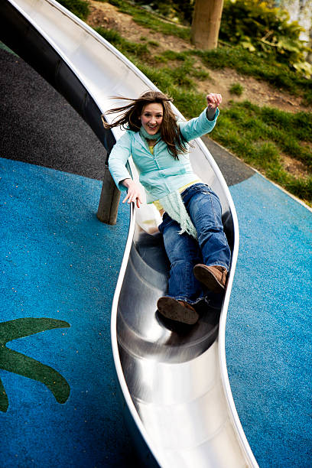
Do Now
Unjumble the words using the definition provided
OREFC a push, pull, or twist
GINSPR ENLAACB tool used to measure force
TWNEON the unit force is measured in
YCEHMTRIS what we studied last term
ESTEHPOYSH prediction of what is going on
NTOEARIVBOS we make these with senses

Slide 2
Observation
Using our senses
Inference
What we think is happening
Independent Variable
What is purposefully changed
Dependent Variable
What is measured
Controlled Variable
What is kept the same

Slide 3
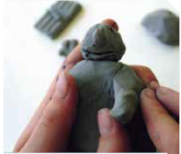

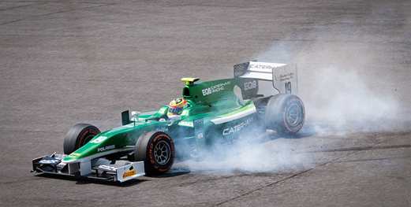
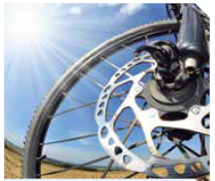
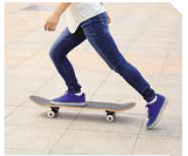
For each picture, describe what the force is doing.

Slide 4
Two students were interested in learning if coffee stays hotter for longer if you use a plastic cup or paper cup. For this experiment:
Independent variable
The cup’s material
Dependent variable
The coffee temperature
Controlled variables
The coffee itself, the coffee’s environment, whether milk was added
Write a hypothesis
The coffee in the plastic cup will stay hotter for longer

Slide 5
Types of Forces
Success Criteria
Identify common contact forces including friction, tension, and the normal force
Identify common non-contact forces, including gravity, magnetic, and electrostatic forces

Slide 6
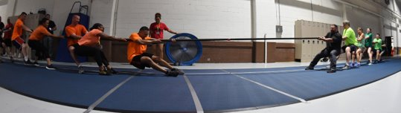
Describe what makes a force “balanced” or “unbalanced”
Tug-of-war is involves forces of push and pull. Teams pull on the rope and remain standing because they push against the ground.​
What do you think would happen if one team pulled harder than the other team (used more force)? ​
What do you think would happen if both teams pull the same amount (with the same amount of force)?​

Slide 7

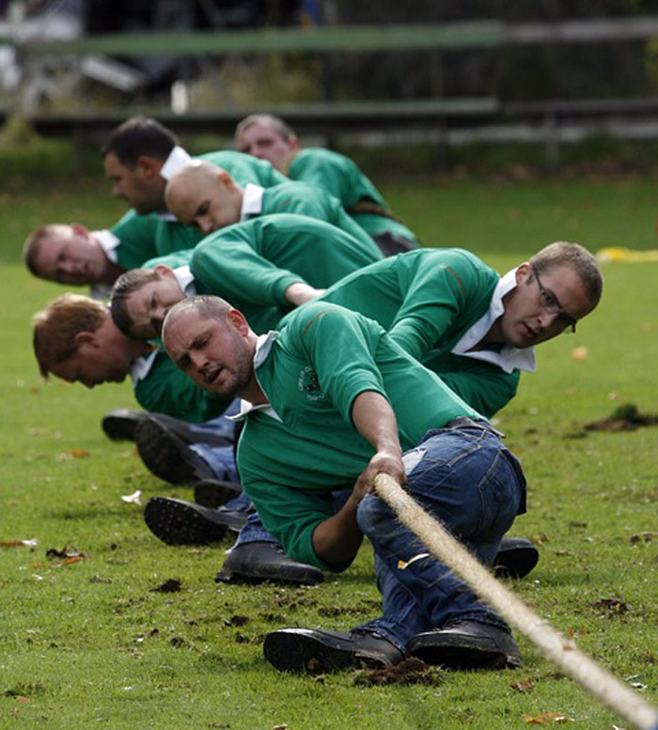
Describe what makes a force “balanced” or “unbalanced”
Forces can be balanced or unbalanced.​ So, in the tug of war example:​
If one team uses more force, the forces are unbalanced forces. One force is larger than the other. ​
If both teams use the same amount of force, the forces are balanced forces. This means the forces are the same size or equal.​

Slide 8
Describe what makes a force “balanced” or “unbalanced”
All forces have two components:

Slide 9
Describe forces as “contact” or “non-contact”
Would the following examples involve contact or non-contact forces?​
A car using its brakes to slow down. ​
A skydiver falling towards the Earth.​
A basketballer making a slam-dunk.​
Making water bend using a rod without the rod touching the water.​
A tin can being attracted to a magnet.​
​
​
​
​

Slide 10
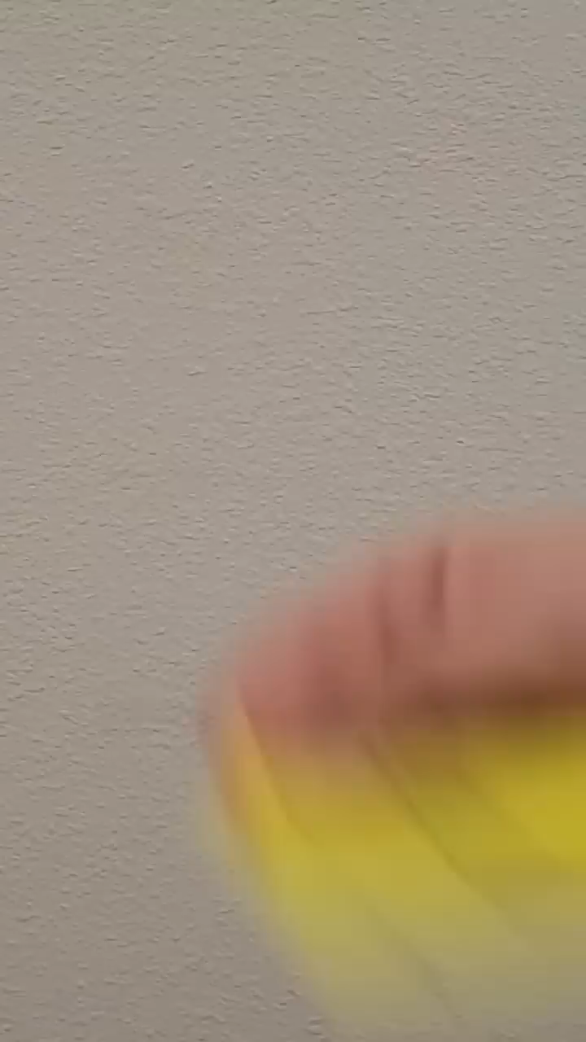
Brain Break
In this video, two of the facts shown are true, and the other is false. See if you can identify which is which before the end!
Notes:
https://www.youtube.com/shorts/HzNycRWlwTw if video doesn’t work

Slide 11

Describe forces as “contact” or “non-contact”
Watch closely!
Your teacher will play the following – take notes, you will be asked to share at least one thing you learned from the video!

Slide 12
List examples of contact and non-contact forces
There are many examples of forces with “names” that we experience in our daily lives. These include:
Buoyancy (allows an object to float on a fluid)
Friction (prevents an object from moving along another object)
Tension (force on a rope when pulled tightly)
Normal (force of the floor pushing up on us)
Gravity (pulls one object towards another)
Electrostatic (force between charged objects)
Magnetic (force between magnets)
Notes:
https://www.youtube.com/watch?v=NqdOyxJZj0U if video doesn’t work

Slide 13
List examples of contact and non-contact forces
Label each force as contact or non-contact:
Buoyancy (allows an object to float on a fluid)
Friction (prevents an object from moving along another object)
Magnetic (force between magnets)
Tension (force on a rope when pulled tightly)
Gravity (pulls one object towards another)
Electrostatic (force between charged objects)
Normal (force of the floor pushing up on us)

Slide 14

Brain Break
In this video, two of the facts shown are true, and the other is false. See if you can identify which is which before the end!
Notes:
https://www.youtube.com/shorts/5Kk60KdWVW8 if video doesn’t work

Slide 15
Explain the impact of contact and non-contact forces
Answer the following questions in your book.
A diver springs off of a board, lands in the pool, then floats to the top. What forces are they likely to experience at each stage?
You slide a book across a table, and it eventually comes to a stop.
What contact force causes it to slow down?
What force prevents the book from falling through the table?
Draw a balloon being held against the ceiling without being tied. Label all the contact and non-contact forces acting on the balloon.

Slide 16
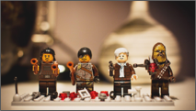
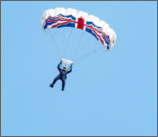




Contact and Non-contact Forces
A force is a push, pull or twist created when two objects interact.​
All forces (interactions) between objects can be placed into two groups:
Contact Forces
Non-contact Forces

Slide 17


Contact and Non-contact Forces
Understanding forces allows us to understand why something will move or stay still. ​
For example, the non-contact force of gravity affects our whole planet.​
Our better understanding of forces has led to many scientific advancements. ​
This includes astronomers using their understanding of forces to launch satellites, and maintain their movement in space.​

Slide 18
Types of Forces
Success Criteria
Identify common contact forces including friction, tension, and the normal force
Identify common non-contact forces, including gravity, magnetic, and electrostatic forces

